Slide 1
CABI Immersive Training
Deep Learning for Demand Forecasting
Day 2

Slide 2
Recap from Day 1
Sara Lee Corporation (Earth Grains Bakery)
Bread and dough scheduling across ~15 regional bakeries
RGA
Lapse Modeling
Propensity Models

Slide 3
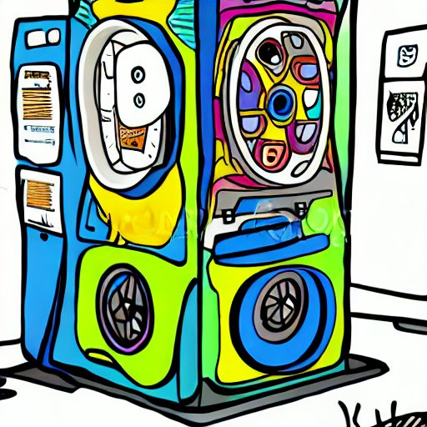
Stable Diffusion Neural Networks

Slide 4
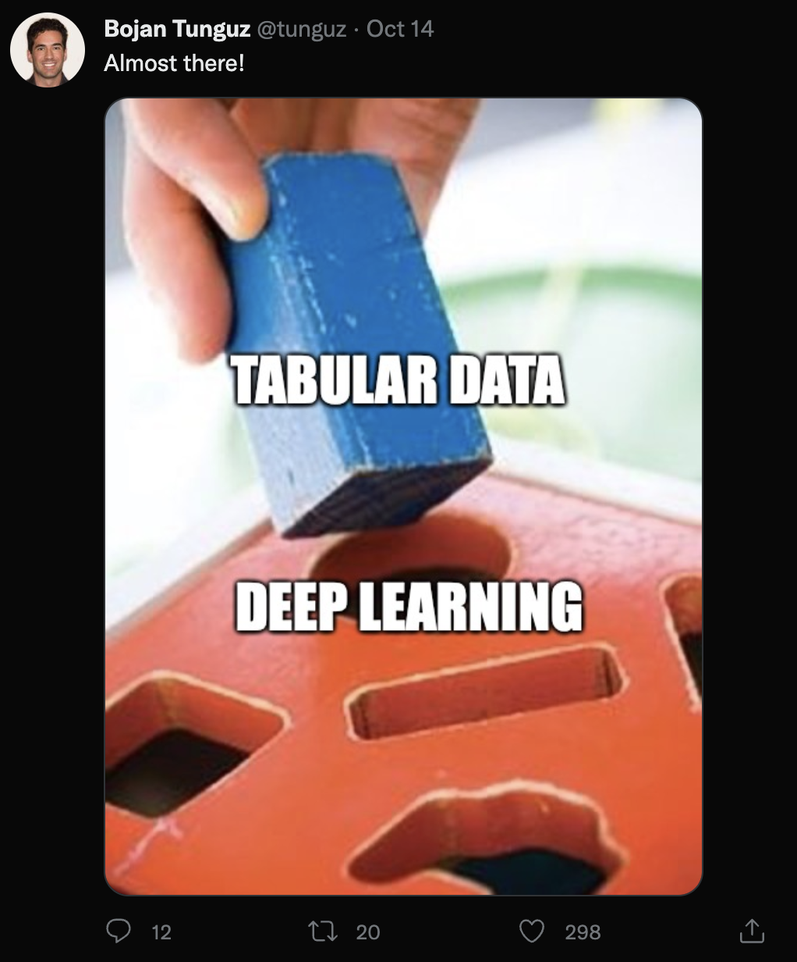
Neural Networks are not Always the Best Choice

Slide 5
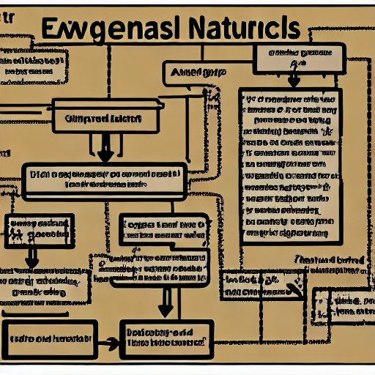
Natural Language Processing
Word2vec

Slide 6
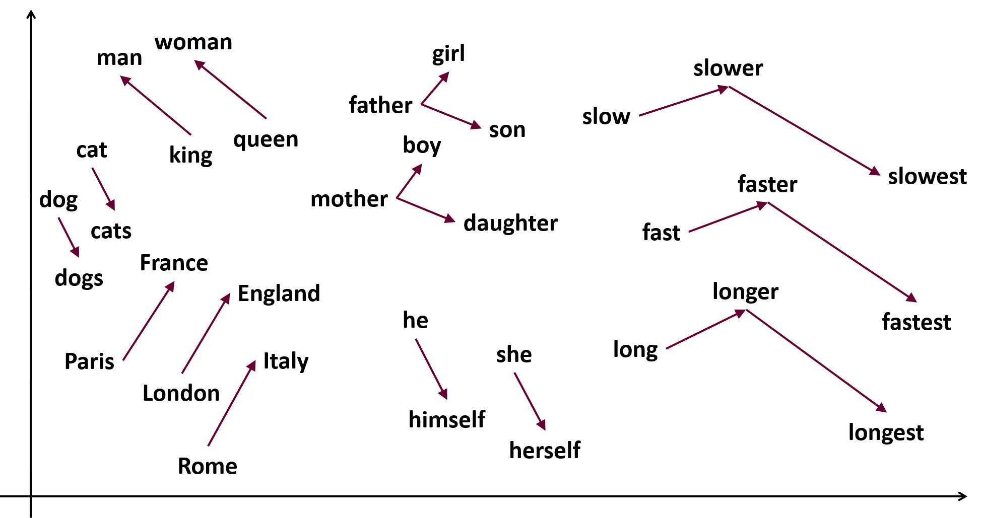
Word2Vec

Slide 7

Deep Learning and Electronic Health Records (HER)

Slide 8
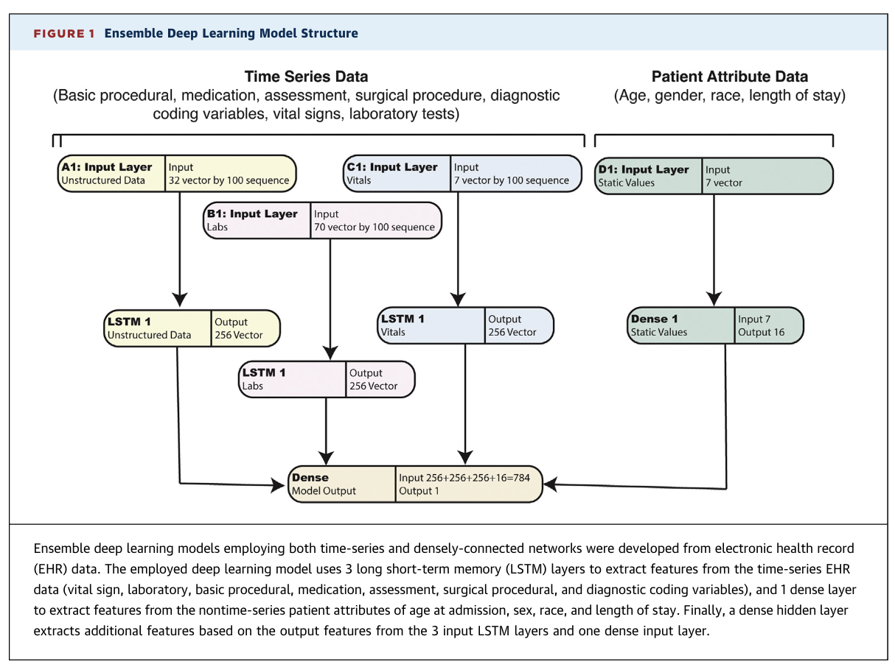
Heterogeneous EMR Neural Network

Slide 9
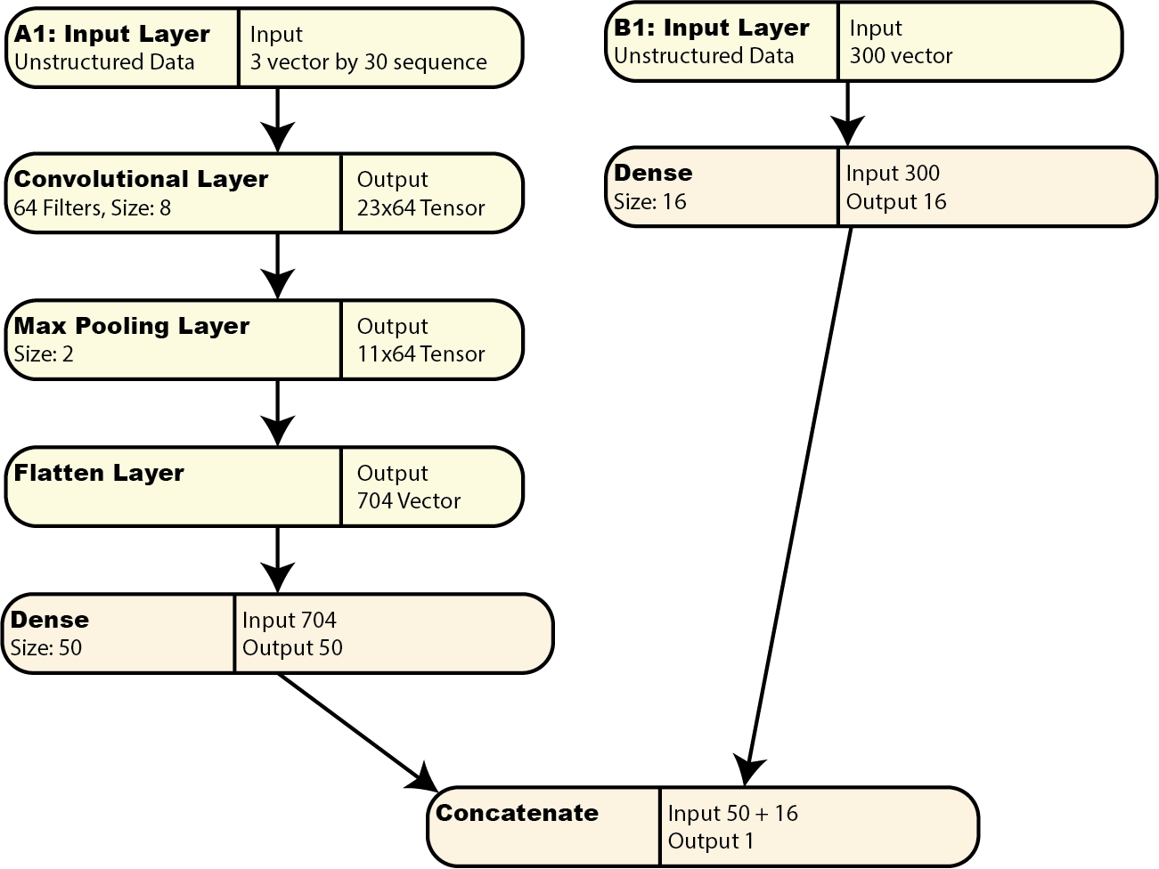
Natural Language Neural Network Structure

Slide 10
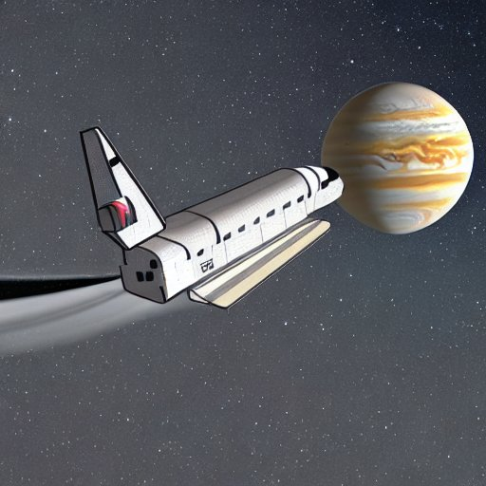
Example: Natural Language Processing (NLP)
https://tinyurl.com/26dcemr3

Slide 11
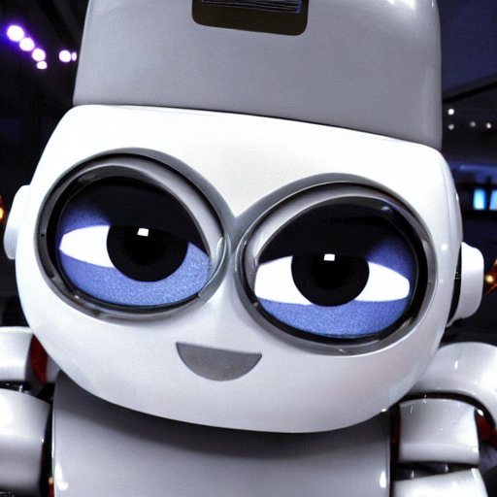
Computer Vision
Additional Time Series feature
People count

Slide 12




Webcam Data

Slide 13

YOLOv5

Slide 14
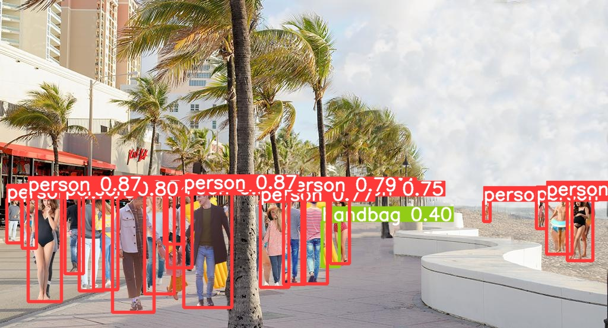
YOLO Identifying Objects

Slide 15
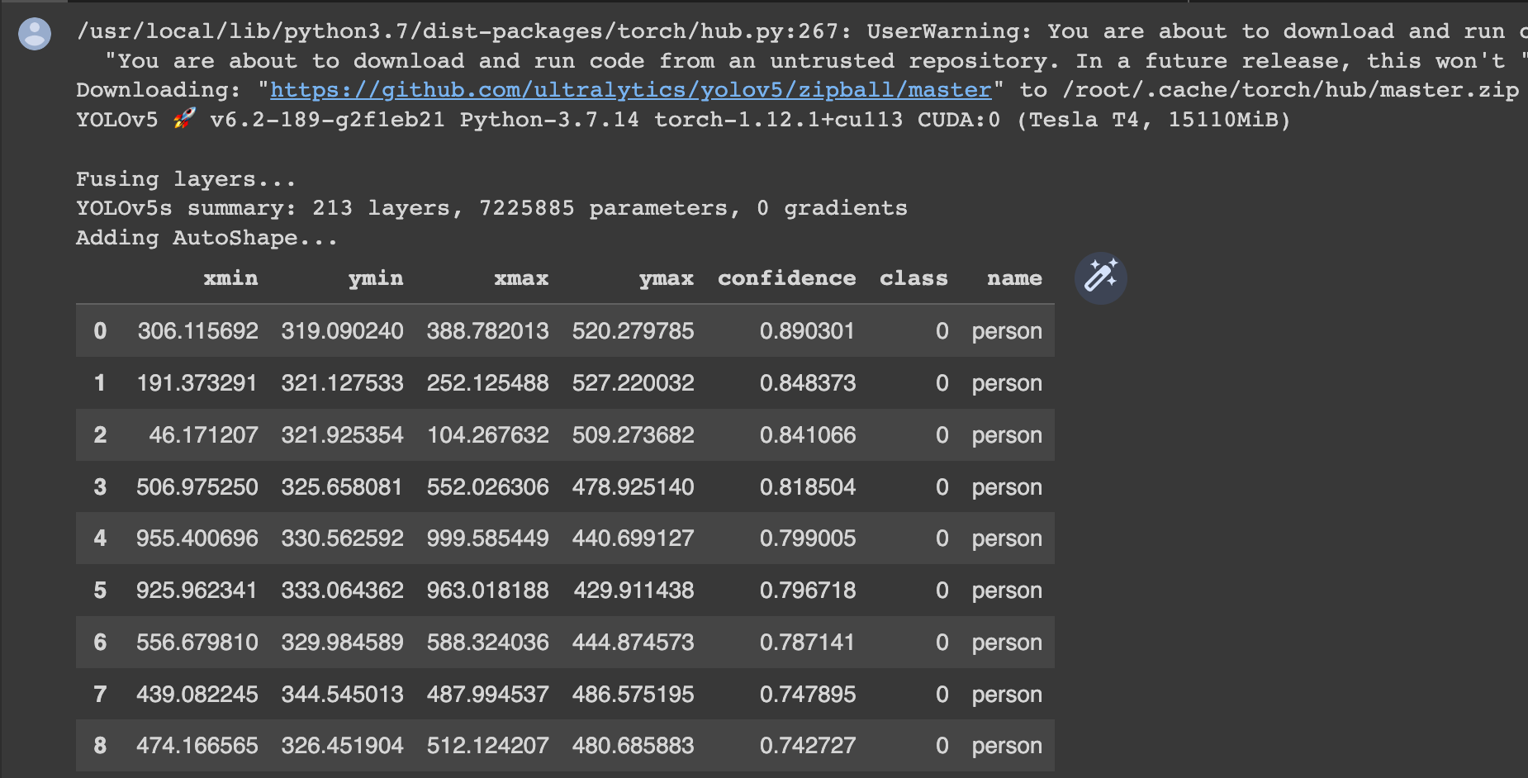
Data from YOLO Identifying Objects

Slide 16
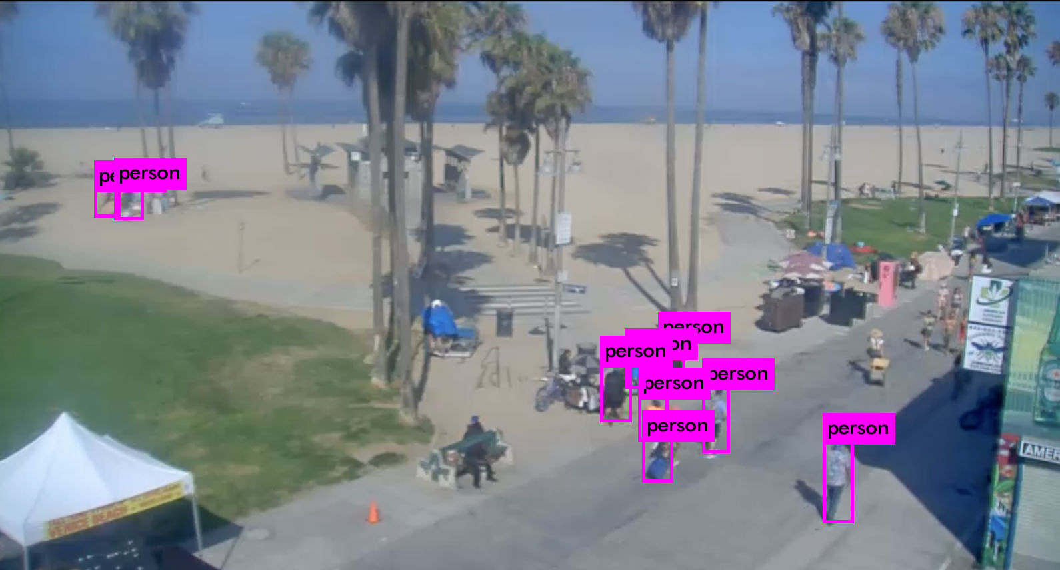
Assignment 7 from Deep Learning Course

Slide 17
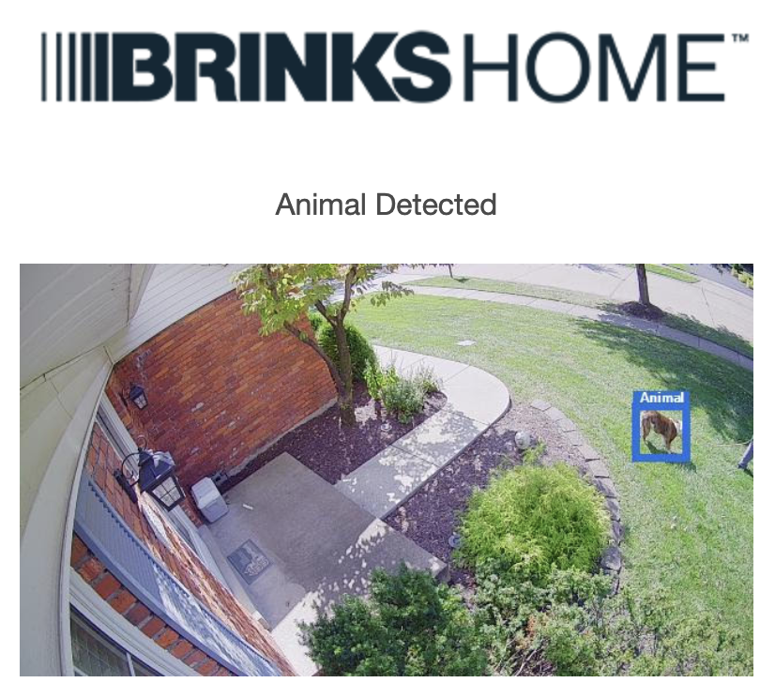
Introducing the Dataset

Slide 18

The Animal that Brinks Detected

Slide 19
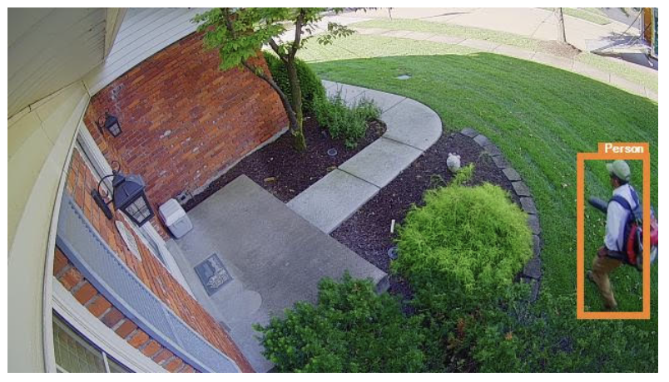
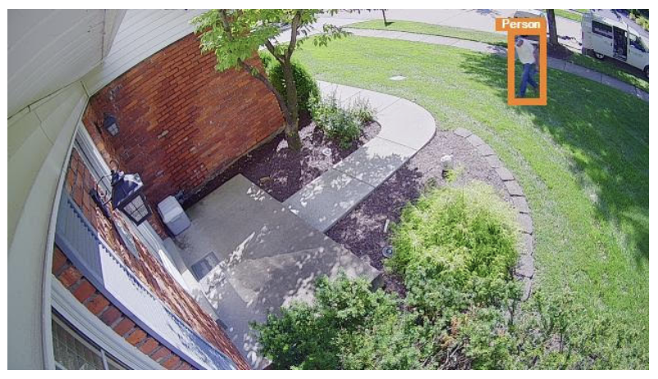
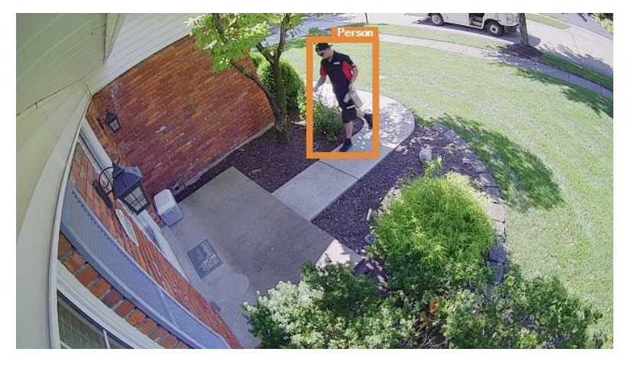
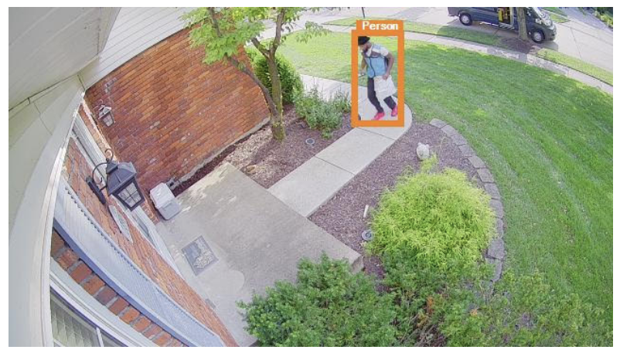
Other Brinks Detections

Slide 20
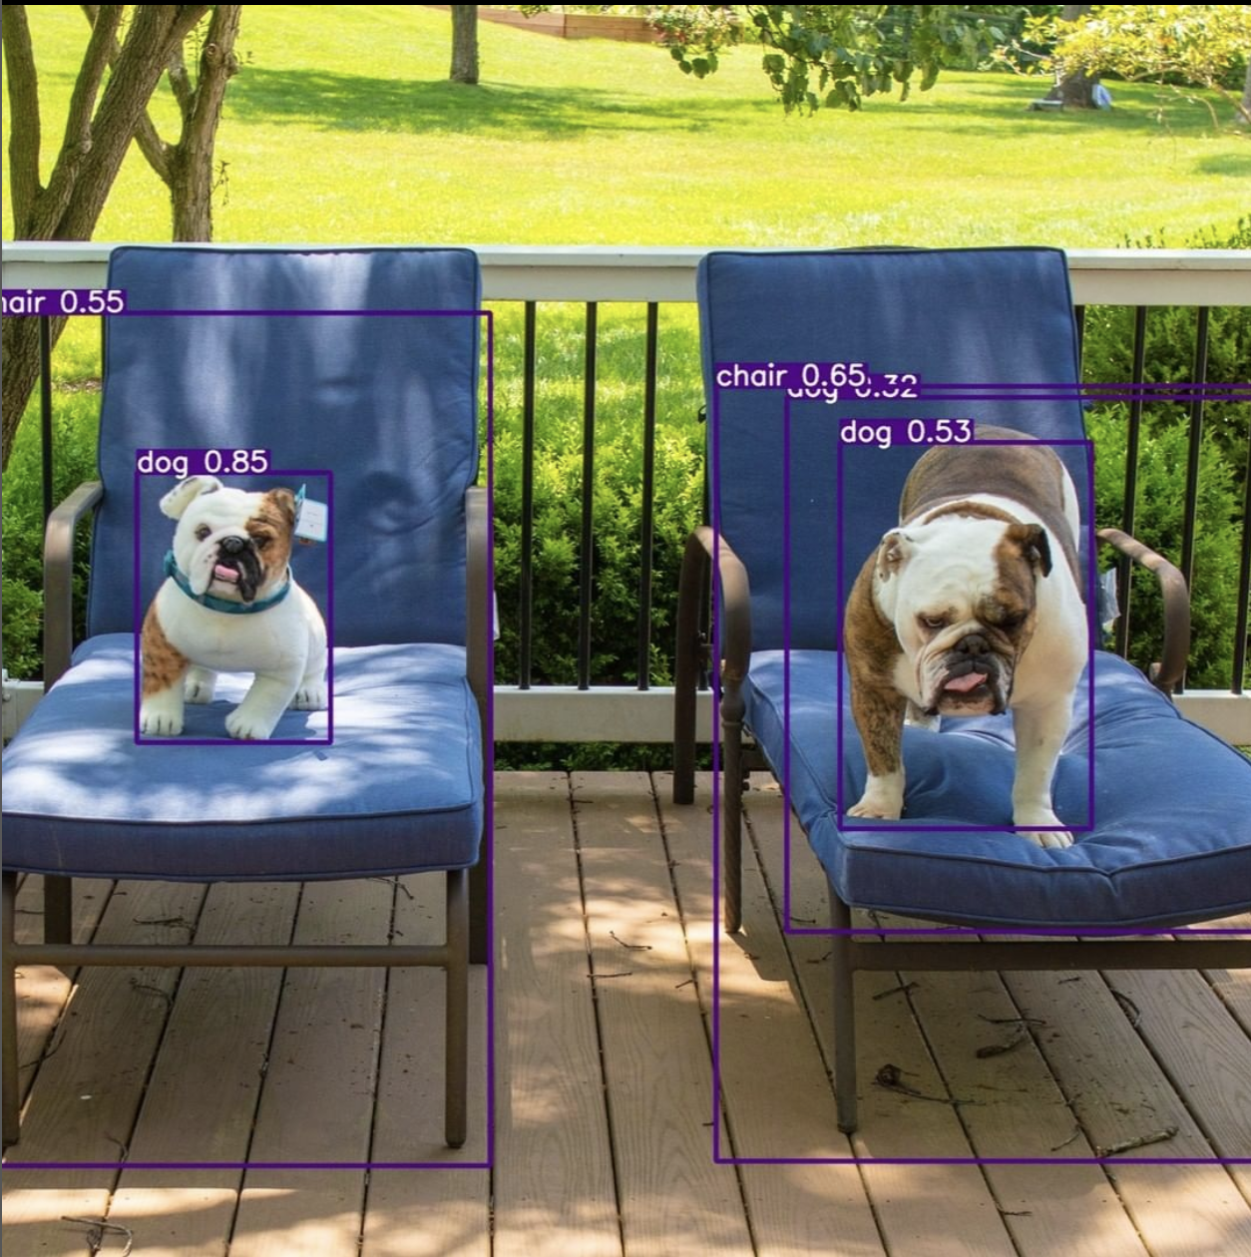
Now I am being mean to YOLO

Slide 21
Engineering Features from the WebCam
Simple case: count the number of people
More complex cases
Detect singles vs couples
Detect children and adults
Detect beach clothes vs street clothes
Add these values as additional engineered features

Slide 22

Computer Vision (+NLP) Network Structure

Slide 23
Example: Computer Vision
https://tinyurl.com/26dcemr3

Slide 24
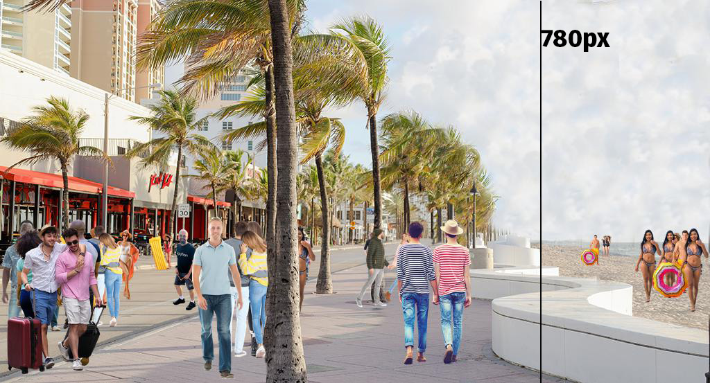
Hint for Detecting People on the Beach

Slide 25
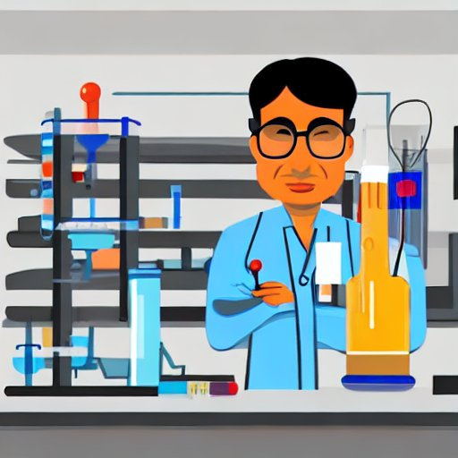
Lab #3: Computer Vision
https://tinyurl.com/26dcemr3

Slide 26

Forecasting with Prophet
Python & R package from Meta (Facebook)
Built on PyTorch neural networks

Slide 27
Profit Pros and Cons
Pros
Minimal code needed to train and forecast from data.
AutoML system, most things are handled automatically.
Cons
Univariate, no official support for multivariate analysis.
Predicting multiple items requires multiple models.
Much less flexability than more custom solutions.

Slide 28
Six Levels of AutoML (credit Bojan Tunguz)
Level 0: No automation. You code your own ML algorithms. From scratch. In C++.
Level 1: Use of high-level algorithm APIs. Sklearn, Keras, Pandas, H2O, XGBoost, etc.
Level 2: Automatic hyperparameter tuning and ensembling. Basic model selection.
Level 3: Automatic (technical) feature engineering and feature selection, technical data augmentation, GUI.
Level 4: Automatic domain and problem specific feature engineering, data augmentation, and data integration.
Level 5: Full ML Automation. Ability to come up with super-human strategies for solving hard ML problems without any input or guidance. Fully conversational interaction with the human user.

Slide 29
Example: Forecasting with Prophet
https://tinyurl.com/26dcemr3

Slide 30
Lab #4: Meta Prophet
https://tinyurl.com/26dcemr3

